Slide 1



UNIT 3
LESSON 10
Did you know?
Part 4

Slide 2
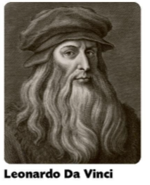
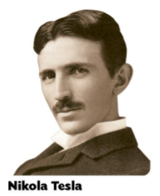
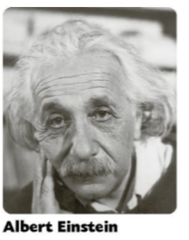
1452 – 1519
Italian
painter, engineer, scientist, theorist, sculptor and architect
The Vitruvian Man, The Last Supper, Mona Lisa
1856 – 1943
inventor, electrical engineer, mechanical engineer
modern alternating current (AC) electricity supply system
SI unit (The International System of Units)
1879 – 1955
physicists
theory of relativity, the theory of quantum mechanics
Nobel Prize in Physics

Slide 3
1 happening now
2 it is laid down when starting to build something
3 have, possess
4 a very tall modern city building
CURRENT
CORNERSTONE
OWN
SKYSCRAPER
1 construct
2 a piece of gossip
3 cause physical harm, especially in accidents
4 land along the side of a river or a lake
5 a building that is easy to recognise
6 take a machine apart so that is in pieces
7 say that something is not true
8 they come from abroad to live in another country
1
BUILD
RUMOUR
INJURE
BANK
LANDMARK
DISMANTLE
BREAKING NEWS
DENY
IMMIGRANTS

Slide 4
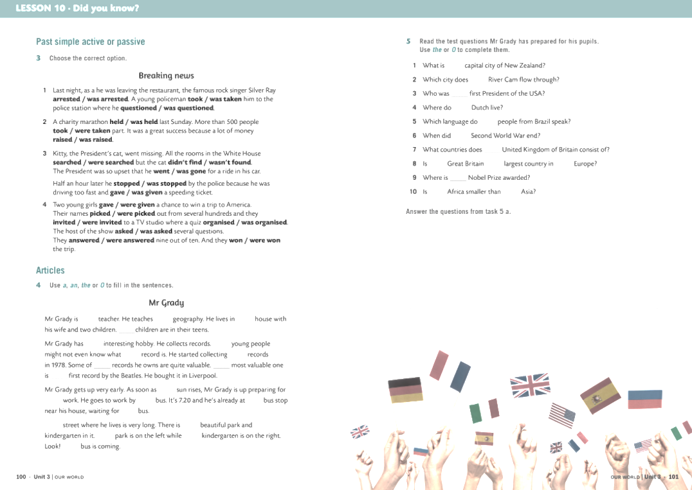
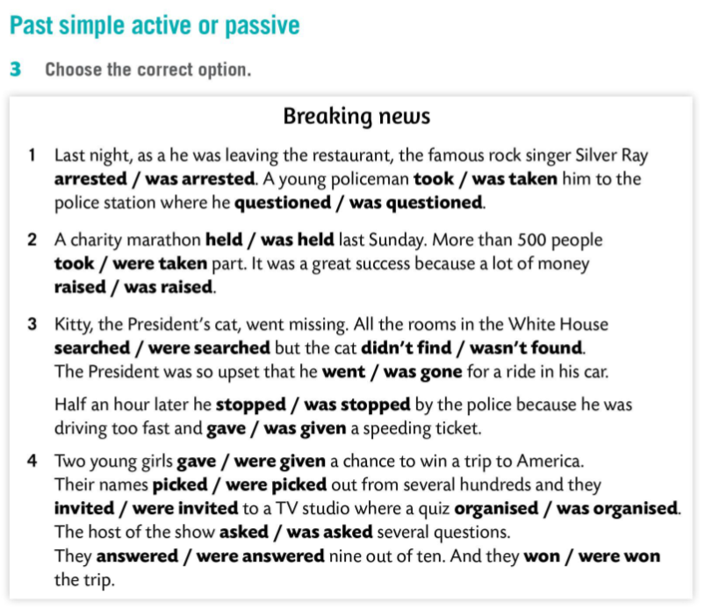

Slide 5
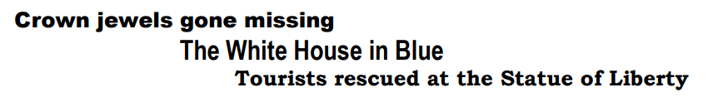

revise

Slide 6
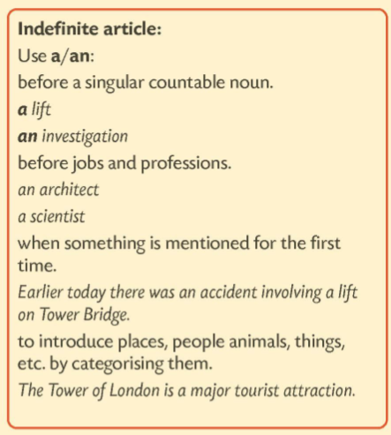
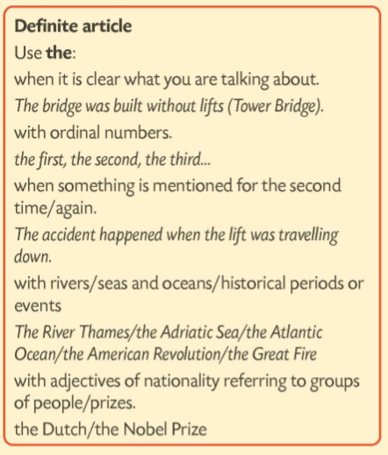
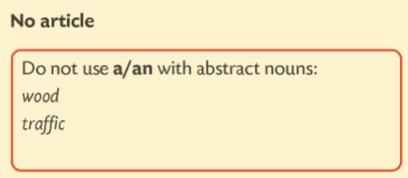
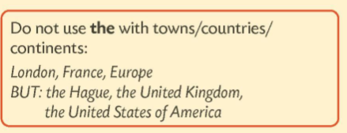

Slide 7
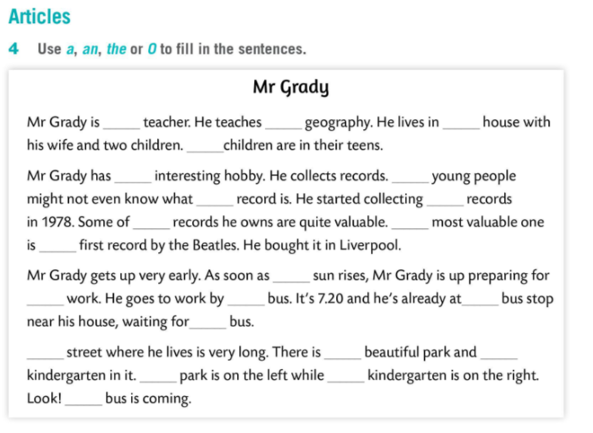
a
/
a
the
an
/
a
/
the
The
the
the
/
/
the
a
The
a
a
The
the
The

